Slide 1
Applied Data Science Capstone Car Accident Severity
Aug 2020

Slide 2

Problem Statement
20-30 million people involved in a road accident
10% lose their life
Old accident record data for Seattle along with accident severity
GOAL:
Develop a machine learning model to predict the future severity of the accident

Slide 3
Data Analysis
Shape: (194673, 38)
If data is balanced: 136485 rows for type 1 compare to 58188 rows for type 2
Selected Features:
'SEVERITYCODE','ADDRTYPE','PERSONCOUNT','PEDCOUNT','PEDCYLCOUNT','VEHCOUNT’, 'INCDTTM','SDOT_COLCODE','INATTENTIONIND’, 'WEATHER’, 'ROADCOND’, 'LIGHTCOND’, 'PEDROWNOTGRNT’, 'SPEEDING’, 'ST_COLCODE’
Fill Nan values with Mode
Change Categorical Data to Dummy Variables

Slide 4
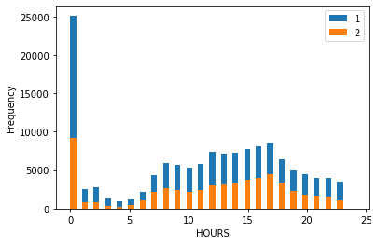
Visualization
The most frequent accidents occurred between 7 am to 7 pm, peak at 12 am!
No relation for Day and Month

Slide 5
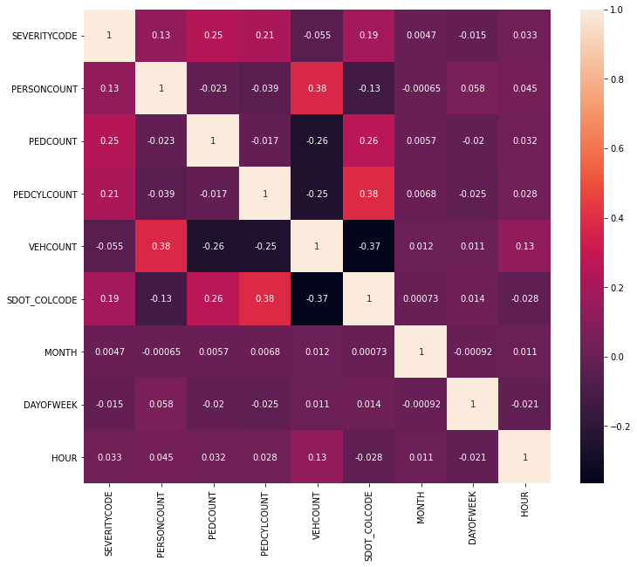
Correlation between features

Slide 6
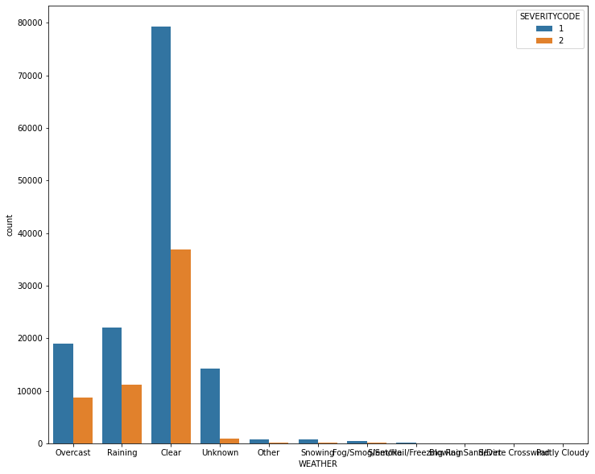
Weather condition

Slide 7
Machine Learning Model
Data was splitted to train (80%) and test (20%) set
Normalized data
Binary Classification: Decision Tree Classifier: criteria: “entropy”
dt = DecisionTreeClassifier(criterion="entropy")
DecisionTreeClassifier(ccp_alpha=0.0, class_weight=None, criterion='entropy', max_depth=None,
max_features=None, max_leaf_nodes=None, min_impurity_decrease=0.0, min_impurity_split=None,
min_samples_leaf=1, min_samples_split=2, min_weight_fraction_leaf=0.0, presort='deprecated’,
random_state=None, splitter='best')

Slide 8
Conclusion
The decision tree model was applied to predict the severity of the car accident
The model had the f1 score of 0.81
The model needs to be updated itself based on new generated data

